Slide 1
Peer-to-Peer (P2P) Scheduling Tool

Slide 2
Schedule a P2P Request
Provider Resources
If your case is eligible for a Peer-to-Peer (P2) consultation, a link will display, allowing you to proceed to scheduling without any additional messaging
Log-in to your account at EviCore.com
Perform Clinical Review Lookup to determine the status of your request
Click on the P2P AVAILABILITY button to determine if your case is eligible for a Peer-to-Peer consultation
Note carefully any messaging that displays*
*In some instances, a Peer-to-Peer consultation is allowed, but the case decision can not be changed. In such cases, you can still request a Consultative-Only Peer-to-Peer. You can also click on the ALL POST-DECISION OPTIONS button to learn what other action can be taken.
Once the Request Peer-to-Peer Consultation link is selected, you will be transferred to our scheduling software via a new browser window.
© 2024 EviCore healthcare. All Rights Reserved. This presentation contains CONFIDENTIAL and PROPRIETARY information.
7/26/2024
2

Slide 3
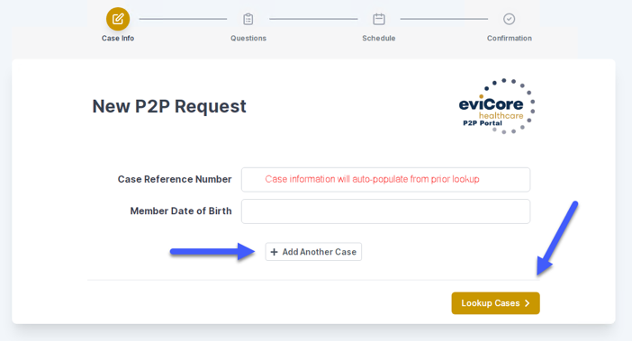
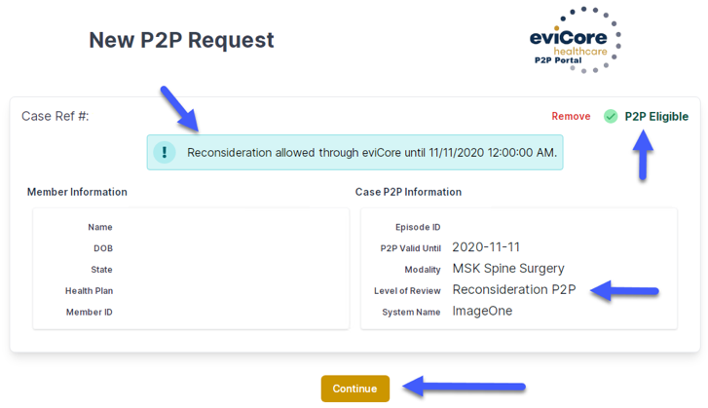
Schedule a P2P Request (con’t.)
Provider Resources
Upon first login, you will be asked to confirm your default time zone
You will be presented with the Case Number and Member Date of Birth
Add another case for the same Peer-to-Peer appointment request by selecting Add Another Case
To proceed, select Lookup Cases
You will receive a confirmation screen with member and case information, including the Level of Review for the case in question
Click Continue to proceed
© 2024 EviCore healthcare. All Rights Reserved. This presentation contains CONFIDENTIAL and PROPRIETARY information.
7/26/2024
3
Notes:
Note! You can add another case for the same Peer to Peer appointment request by selecting “Add Another Case” (maximum of 4 cases, some restrictions may apply*)
There might be times when we are unable to accommodate more than one case with the same eviCore reviewer. This is usually because different credentials or licensure types are needed for one or more of the cases in question. You will receive a prompt to schedule these separately when this occurs.

Slide 4
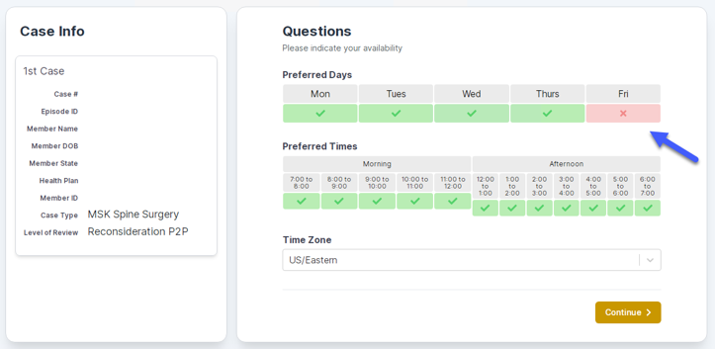
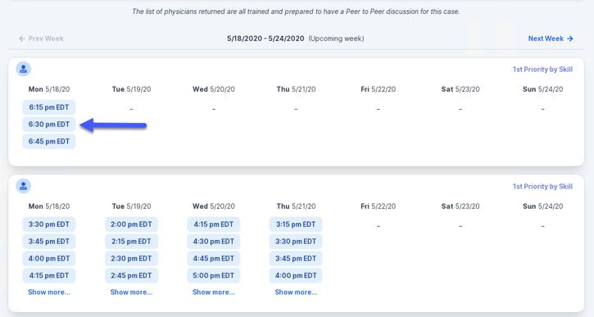
Schedule a P2P Request (con’t.)
Provider Resources
You will be prompted with a list of EviCore Physicians / Reviewers and appointment options
Select any of the listed appointment times to continue
You will be prompted to identify your preferred days and times for a Peer-to-Peer consultation (all opportunities will be automatically presented)
Click on any green checkmark to deselect that option and then click Continue
© 2024 EviCore healthcare. All Rights Reserved. This presentation contains CONFIDENTIAL and PROPRIETARY information.
7/26/2024
4

Slide 5
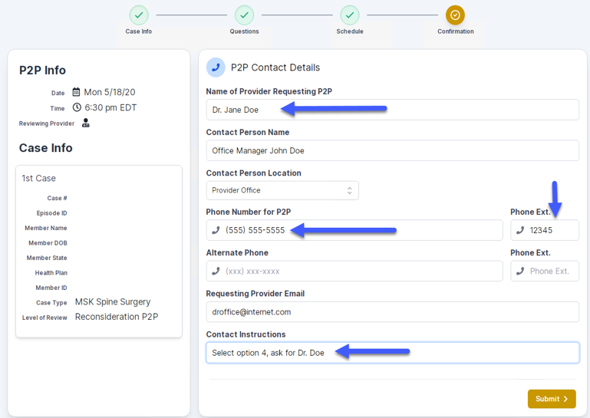
Schedule a P2P Request (con’t.)
Provider Resources
Update the following fields to ensure the correct person is contacted for the Peer-to-Peer appointment:
Name of Provider Requesting P2P
Phone Number for P2P
Contact Instructions
Click Submit to schedule the appointment
You will be presented with a summary page containing the details of your scheduled appointment
Confirm contact details
© 2024 EviCore healthcare. All Rights Reserved. This presentation contains CONFIDENTIAL and PROPRIETARY information.
7/26/2024
5
Notes:
Note: You will also receive a confirmation email with a calendar invite to the Peer-to-Peer appointment.

Slide 6
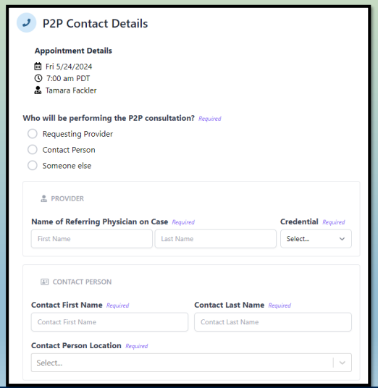
P2P Contact Details
Provider Resources
Use the radial button option to select who will perform the P2P with the EviCore Medical Director
Open fields will manually open to input the provider’s First, Last Name and their credential
© 2024 EviCore healthcare. All Rights Reserved. This presentation contains CONFIDENTIAL and PROPRIETARY information.
7/26/2024
6
Notes:
Note: You will also receive a confirmation email with a calendar invite to the Peer-to-Peer appointment.

Slide 7
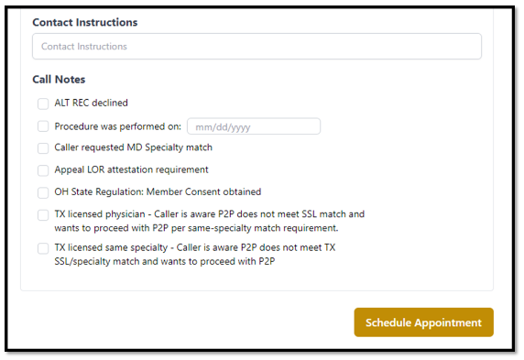
Call Notes
Provider Resources
Use the radial button to select options if applicable
If ‘Procedure was performed on’ is selected, the date is required
© 2024 EviCore healthcare. All Rights Reserved. This presentation contains CONFIDENTIAL and PROPRIETARY information.
7/26/2024
7
Notes:
Note: You will also receive a confirmation email with a calendar invite to the Peer-to-Peer appointment.

Slide 8
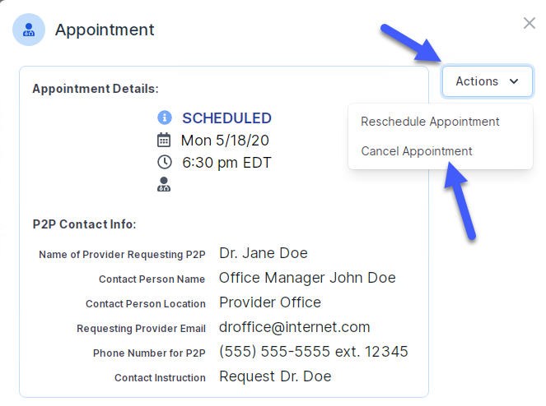
Cancel or Reschedule a P2P Appointment
Provider Resources
To cancel or reschedule an appointment:
Access the scheduling software and select My P2P Requests on the left-pane navigation
Select the request you would like to modify from the list of available appointments
When the request appears, click on the schedule link. An appointment window will open
Click on the Actions drop-down and choose the appropriate action
If choosing to reschedule, select a new date or time as you did initially
If choosing to cancel, input a cancellation reason
Close the browser once finished
© 2024 EviCore healthcare. All Rights Reserved. This presentation contains CONFIDENTIAL and PROPRIETARY information.
7/26/2024
8

